Slide 1
ONLINE FOOD ORDERING SYSTEM
GROUP NO. 16
18BCA086 – SOURAV AGRAWAL
18BCA088 – SAHIL MANSURI
18BCA132 – DIVYANSH JAIN
Internal Guide : Ms. Manali Brahmbhatt
External Guide :Mr. Jugal Prajapati

Slide 2
INDEX
About Company
Company Details
Project Description
Requirement Gathering
Tools and Technologies Used
Existing System
Proposed System
Context Level/0 Level DFD
Level 1 DFD

Slide 3
About Company
Aarnik Technology, as a website development company, holds a repu-ted image among its competition.
Company believes on developing completely unique and outstanding websites.
Aarnik Technology has always assured the best services to its clients as it has professionals working for its clients.
It excels in fields like website development, mobile app development, digital marketing, and ERP software development.

Slide 4

Company Details
Company Name : Aarnik Technlogy
Address : K8 Krishna Centre, Navrangpura, Ahmedabad 380009
Email Address : info@aarniktechnology.com
Contact Number : 9586248516

Slide 5
About Project
The Online Food Ordering System is a food ordering website. It
provides convenience to the users by providing online ordering
system and overcomes disadvantages of the traditional
queuing systems.
It gives restaurants the ability to increase their sales and expand
their business.
With Online Food Ordering system, we can setup restaurant menu
online and customers can also track their orders with few simple
steps.

Slide 6
Requirement Gathering
What we have come up with is, an online food ordering system which is
completely web-based. This system can be a proven solution in today’s
modern world where people live a busy life.
In this system, admin can approve restaurant users to register on the website to accept orders, the admin can also look at the food items being sold restaurants, he can also manage order details, payment details and can also generate reports.
The restaurants can manage food items, accept orders, create menu categories, they can accept payments using the website
Today inflation rates are increasing rapidly, so in such time to have a
fine dining experience at the restaurant is not feasible for everyone.
This way people can have their favourite food delivered at their home.

Slide 7




Tools and Technologies Used
Frontend : Python Django v3.1
Backend : MySQL v5.6
Other Tools: Edraw Max 9.0,
Microsoft PowerPoint 2010

Slide 8
Existing System
In the old manual systems, there were series of drawbacks, as the whole system was maintained by humans. The processes consisting of keeping, maintaining and retrieving the data were very time consuming.
Records were never easily stored in sorted order and hence problems kept arising at the time of data retrieval.
Detecting errors in the data was also a big problem for restaurants with a large customer base and high frequency of orders.
Generation of reports was not easy for financial planning, as there would rise problems such as data redundancy and incomplete data.

Slide 9
Proposed System
In some of the existing systems, Users must have a physical menu to order their food over a telephonic communication, this can often result
into misunderstanding due to unclear communication through
telephones.
What we propose is, a website-based Online food ordering system which can ease the problems of almost all users connected to it.
Using the Online Food Ordering System, users can order food through the website without standing in lines in front of the restaurant.
The users can manage their cart and can place orders from their carts, they can also track the delivery status of their orders, they can make payments using the website.
This system helps restaurants to manage all information regarding orders, their customers, payment related activities and feedbacks on a central server, the information can be retrieved as and when required.
To improve the user’s experience, the system also allows users to search based on names of dishes, and restaurants.

Slide 10
Context Level DFD / 0 Level DFD

Slide 11
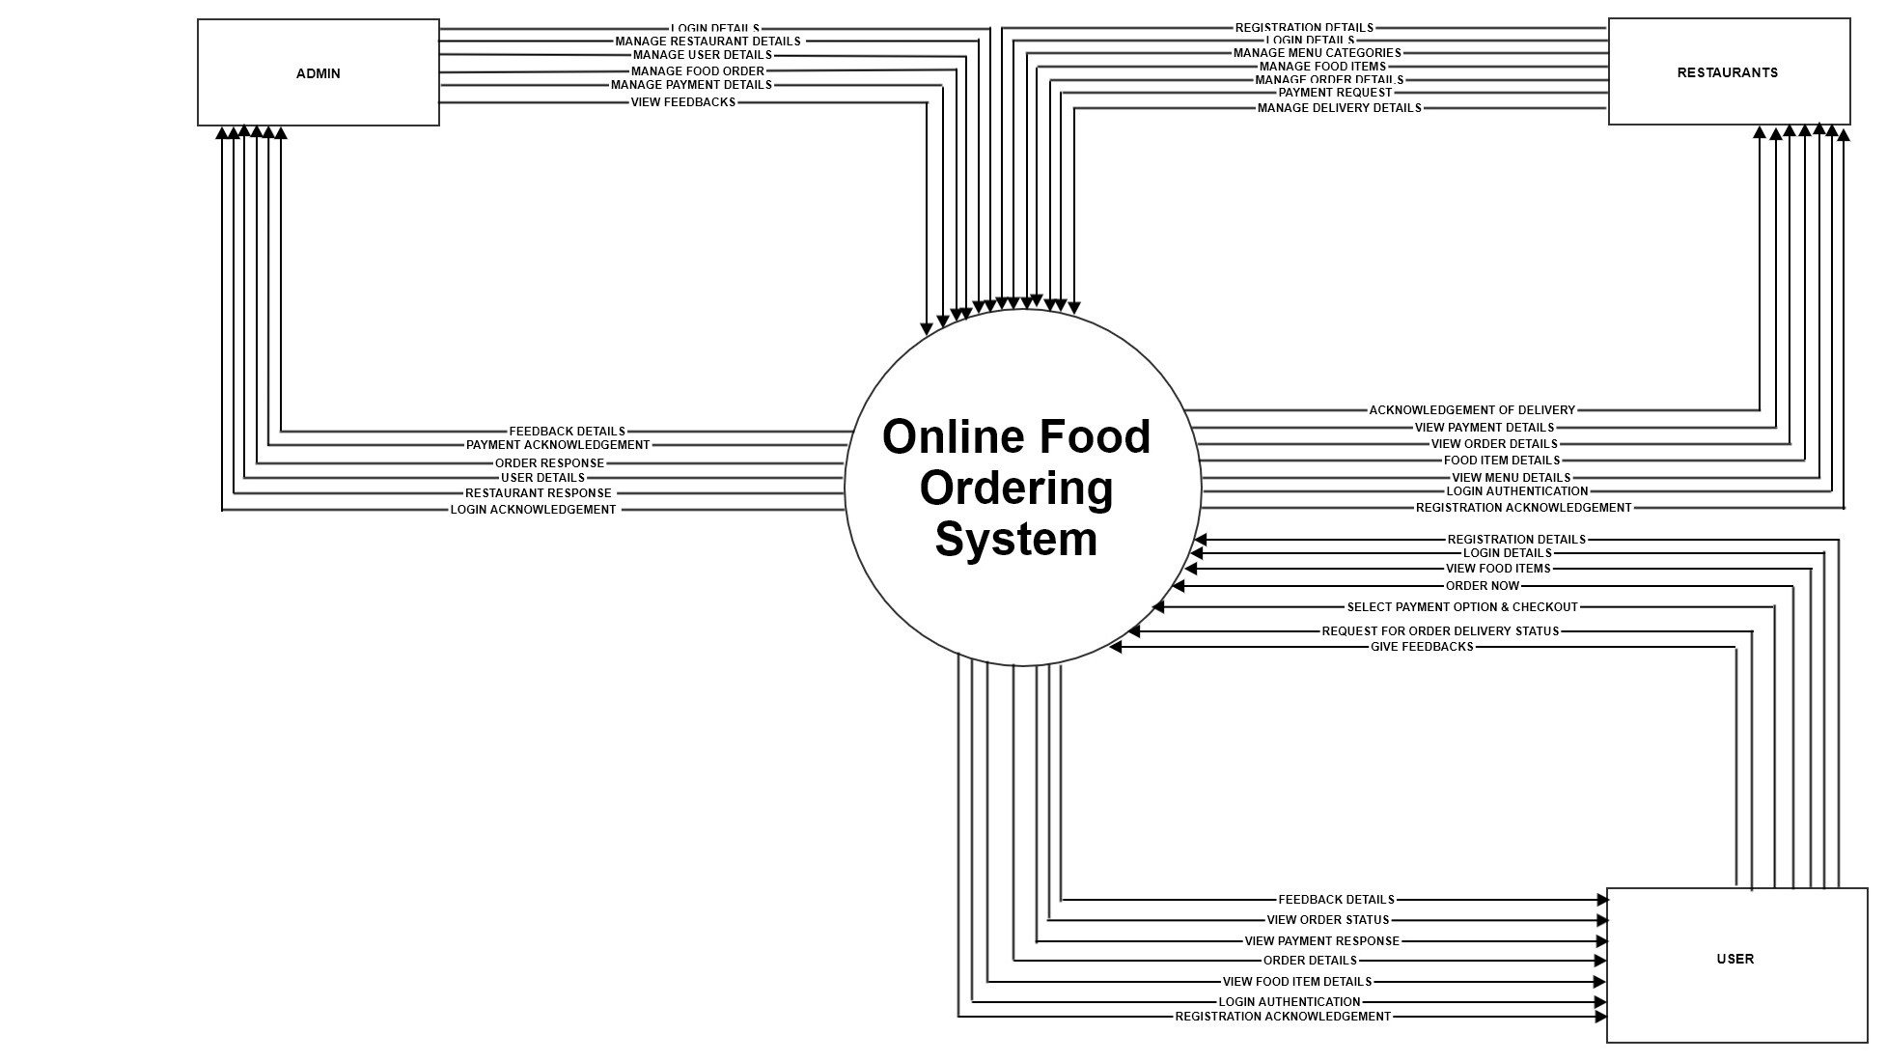

Slide 12
Level 1 DFD

Slide 13
